Slide 1

Basaveshwar Engineering College,Bagalkot
Department of electronics and communication
Title :Steering Control using Verilog
Faculty :
Prof. M C Aralimarad
Submitted by :
Siddeshkumar k ,Usn :2BA20EC082
Naveen ,Usn :2BA20EC041

Slide 2
Steering control :
The purpose of this code is to examine the output of each of the reflectance sensor, and tell how motors need to engage to get the car back on track.
Depending on the relative position to the black line, the code will decide which way to turn. For instance, if the right most sensor is engaged, it means that the car is on the left side of the track, and needs to turn right to stay on track.
The steering is done by one side of the car going in one direction, and the other side going in the opposite direction (like a tank).
This part helps us achieve the correct motion of the car by telling which motors need to engage, and in what direction. This is a decision-making algorithm for the car, and is equivalent to a human steering the wheel in the appropriate direction.

Slide 3
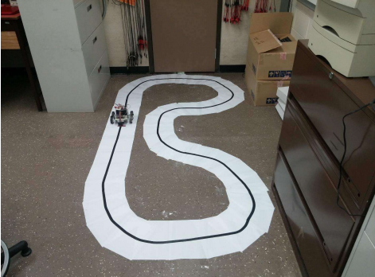
The car on the track

Slide 4
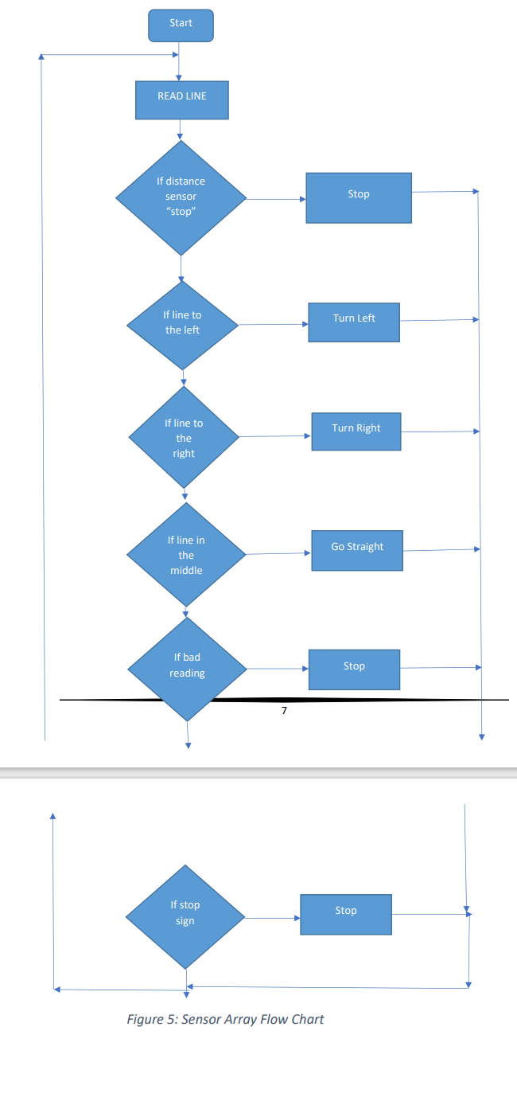
The QTR-8RC Reflectance Sensor will send input data as 8bit binary form
The sensor emits (mostly) infrared light, which is reflected as soon as an object enters into the light cone.
Short decay time indicates good reflectance (white surface), and long decay time indicates poor reflectance (black surface).
Ultimately it provides an 8-bit array that is composed of binary bits, where 0 stands for a sensor being on the white surface, and 1 stands for the sensor being on the black surface.
This QTR-8RC sensor provides the information about the position of the car.

Slide 5
Code :
else if(stop) begin
Rmotor <= 0;
Lmotor <= 0;
end
else begin
Rmotor <= Rmotor;
Lmotor <= Lmotor;
end
end
// Output the direction based on the reflectance sensor outputs.
always_comb begin
if (ledso == 8'b00011000 || ledso == 8'b00010000 || ledso ==
8'b00001000)
begin
straight = 1;
turnRight = 0;
turnLeft = 0;
stop = 0;
end
module direction( input logic [7:0] ledso,
output logic [1:0] Lmotor, Rmotor, input logic clk, reset );
// Direction variables.
logic straight, turnRight, turnLeft, stop;
// Output motor direction binary signals.
always_ff@(posedge clk)
begin
if(straight)begin
Lmotor <= 1;
Rmotor <= 1;
end
else if(turnRight)begin
Rmotor <= 0;
Lmotor <= 1;
end
else if(turnLeft)begin
Rmotor <= 1;
Lmotor <= 0;
end

Slide 6
else if (ledso == 8'b00001100 || ledso == 8'b00000100 || ledso ==
8'b00001000)
begin
turnRight = 1;
straight = 0;
turnLeft = 0;
stop = 0;
end
else if (ledso == 8'b00000110
|| ledso == 8'b00000100
|| ledso ==8'b00000010 )
begin
turnRight = 1;
straight = 0;
turnLeft = 0;
stop = 0;
end
turnRight = 1;
straight = 0;
turnLeft = 0;
stop = 0;
end
else if (ledso == 8'b00000001)
begin
turnRight = 1;
straight = 0;
turnLeft = 0;
stop = 0;
end
else if (ledso == 8'b00110000
|| ledso == 8'b00010000
|| ledso ==8'b00100000)
begin
turnLeft = 1;
turnRight = 0;
straight = 0;
stop = 0;
end
else if (ledso == 8'b00000011)
begin

Slide 7
else if (ledso == 8'b01100000 || ledso == 8'b00100000 || ledso ==
8'b01000000)
begin
turnLeft = 1;
turnRight = 0;
straight = 0;
stop = 0;
end
else if (ledso == 8'b11000000 || ledso == 8'b01000000)
begin
turnLeft = 1;
turnRight = 0;
straight = 0;
stop = 0;
end
turnRight = 0;
straight = 0;
stop = 0;
end
// 3 SENSORS ENGAGED
else if (ledso == 8'b00011100)
begin
straight = 1;
turnRight = 0;
turnLeft = 0;
stop = 0;
end
else if (ledso == 8'b00001110)
begin
turnRight = 1;
straight = 0;
turnLeft = 0;
stop = 0;
end
else if (ledso == 8'b10000000)
begin
turnLeft = 1;

Slide 8
else if (ledso == 8'b00000111)
begin
turnRight = 1;
straight = 0;
turnLeft = 0;
stop = 0;
end
else if (ledso == 8'b00111000)
begin
turnLeft = 1;
turnRight = 0;
straight = 0;
stop = 0;
end
else if (ledso == 8'b01110000)
begin
turnLeft = 1;
turnRight = 0;
straight = 0;
stop = 0;
end
else if (ledso == 8'b11100000)
begin
turnLeft = 1;
turnRight = 0;
straight = 0;
stop = 0;
end
else
begin
turnLeft = 0;
turnRight = 0;
straight = 0;
stop = 1;
end
end
endmodule

Slide 9
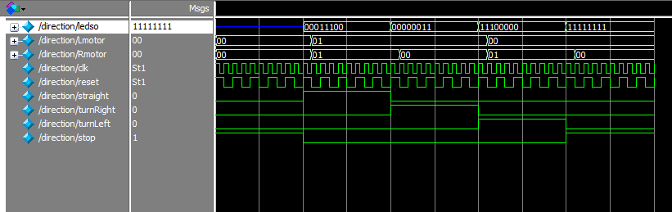
Output:

